Slide 1

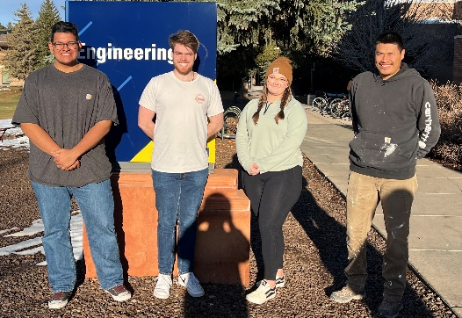

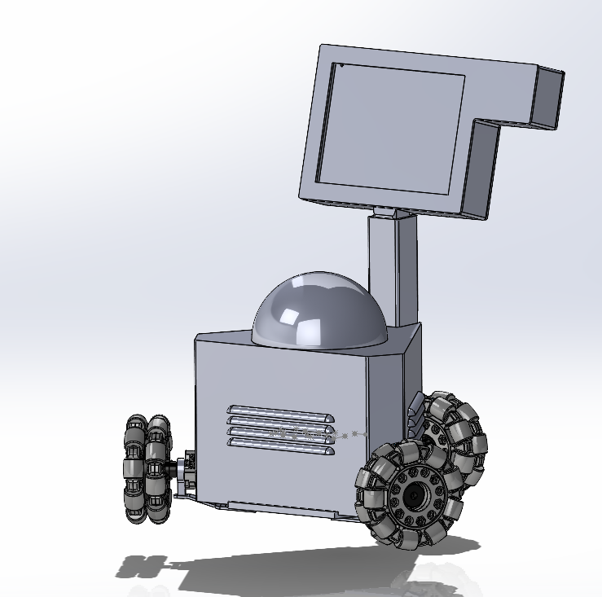
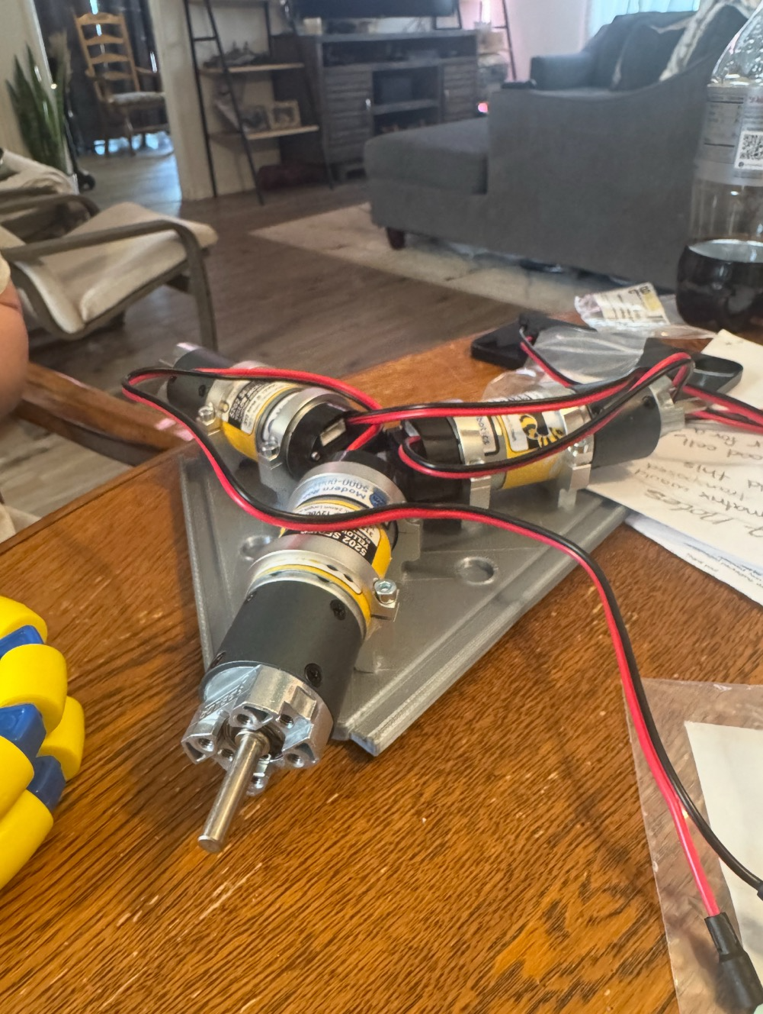
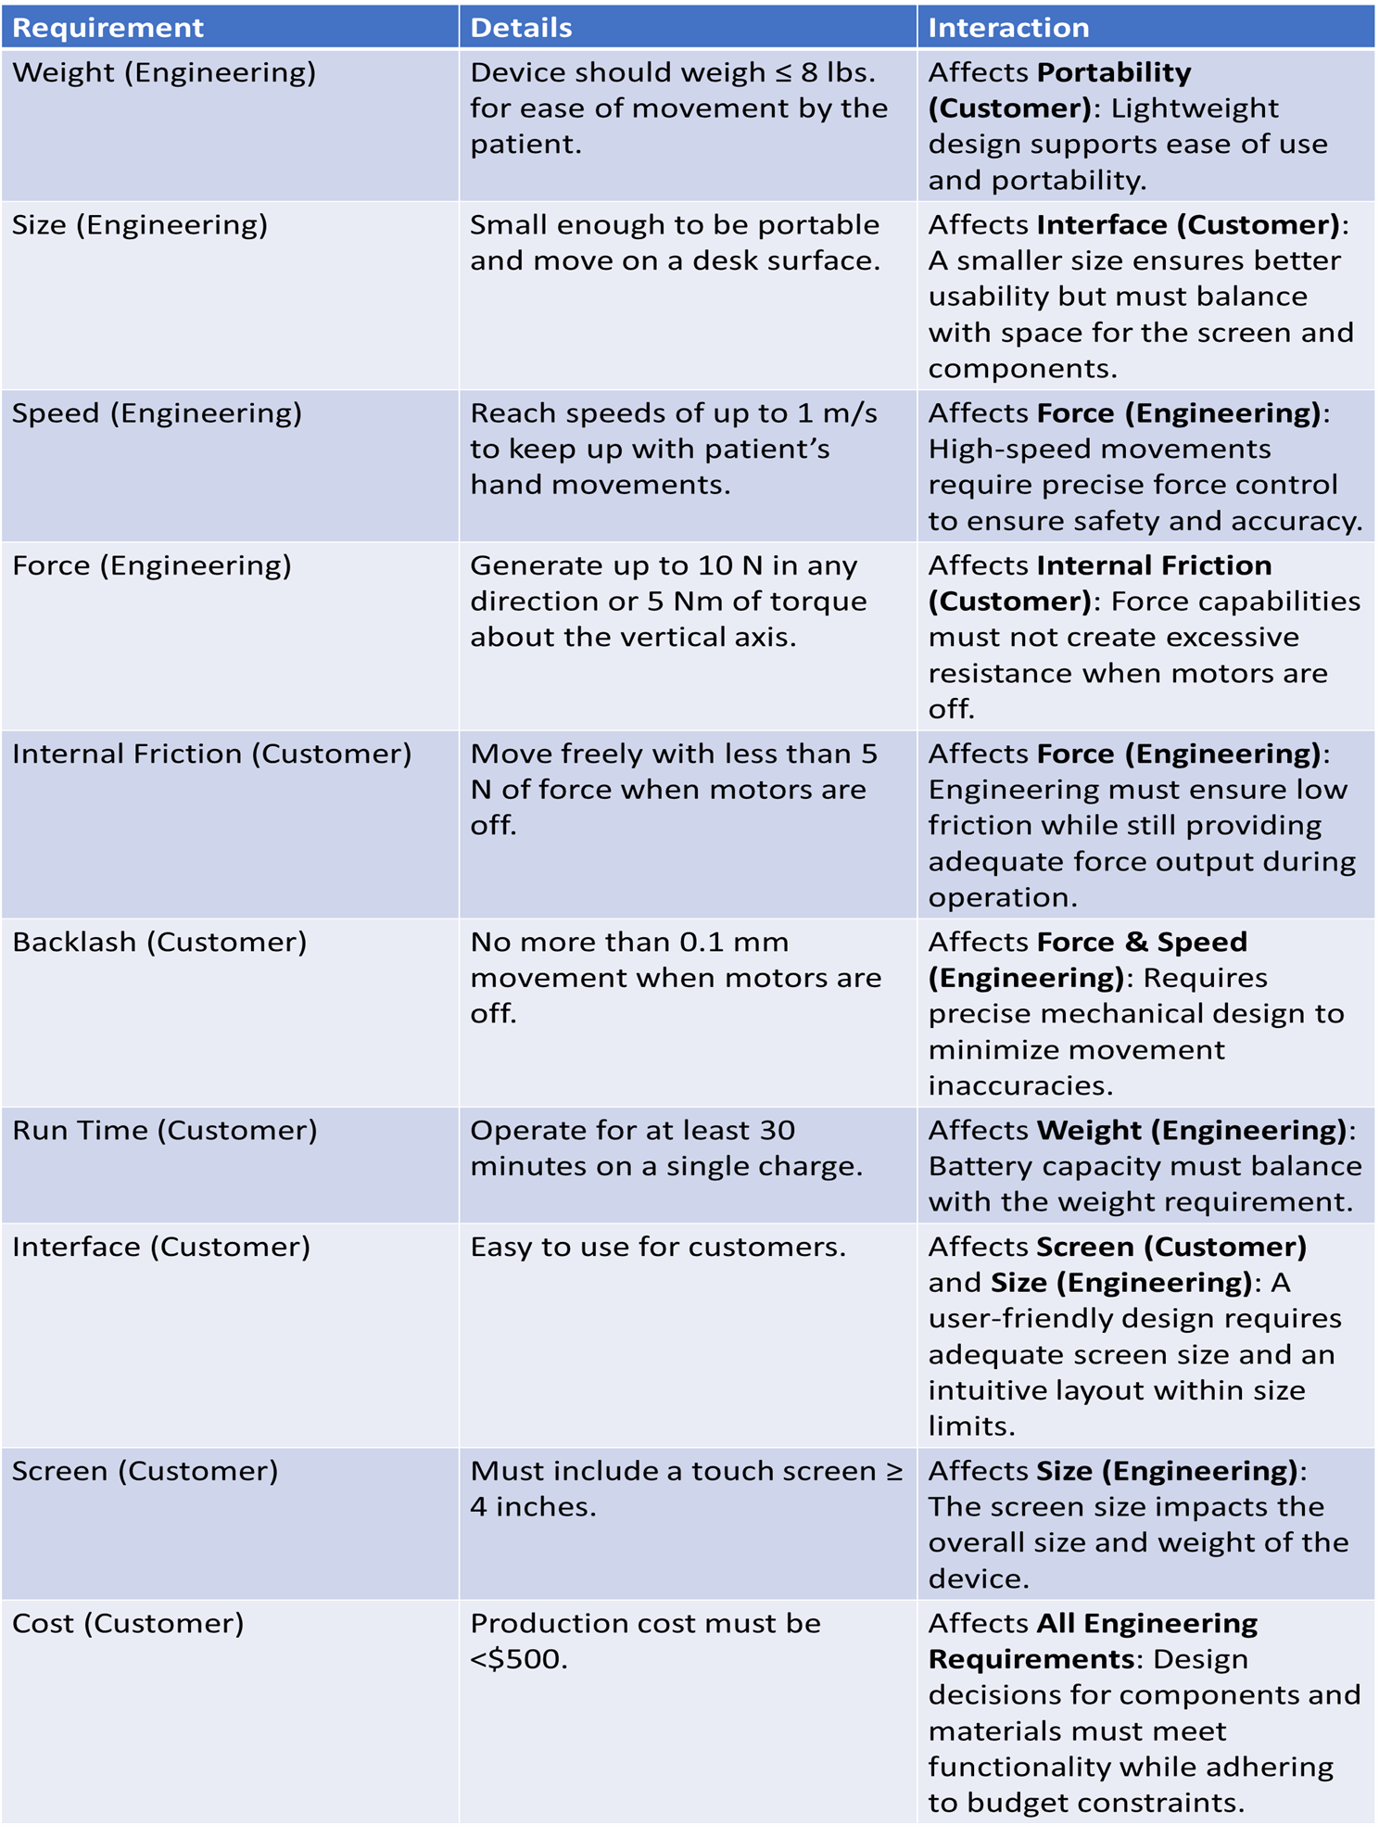
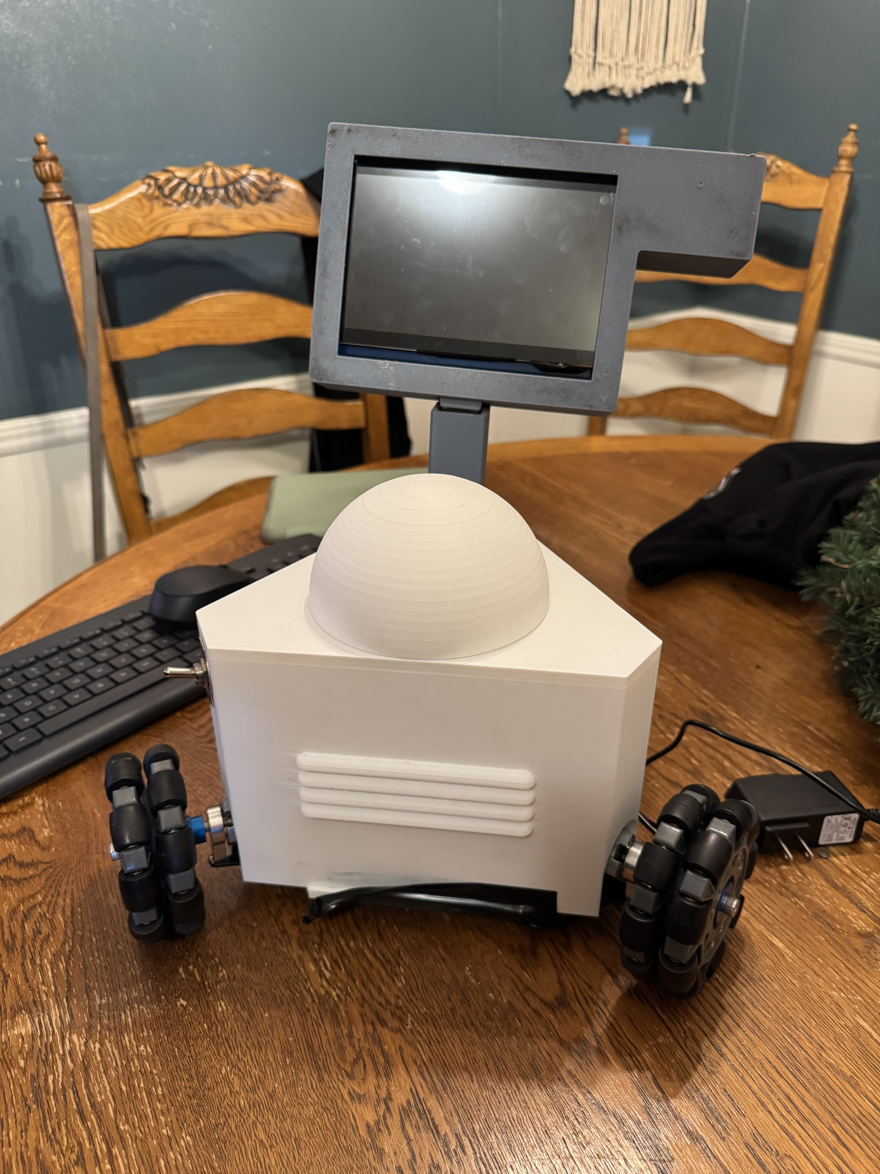
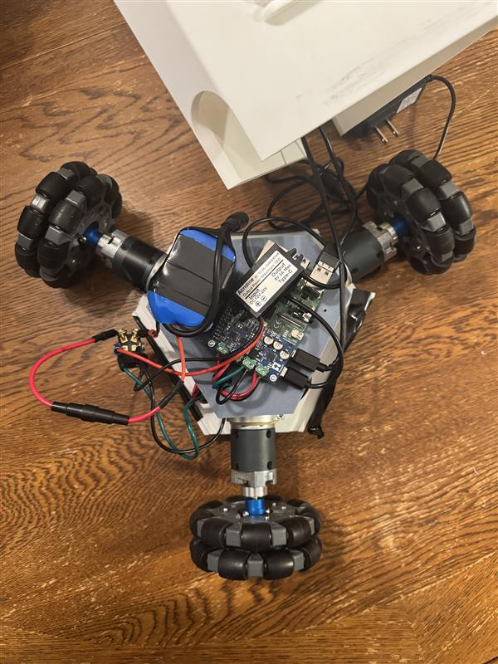
Semester: Fall 2024
Robotic at home physical therapy for stroke patients
Joseph Lopez, Jared Hemauer, Rylee Horney, Keenan Keams
Sanghi College of Engineering, Northern Arizona University,
Flagstaff, AZ 86011
Abstract
Methods
Conclusion
Human-Assisted Motorized Stroke Therapy Enabler and Rehabilitation robot also known as HAMSTER. The goal of the project was to give stroke patients worldwide access to less expensive at-home physical treatment. The problem with current stroke recovery procedures is that they are very costly and require highly specialized equipment that is only available at physical therapy offices. Many patients are unable to pay for the care or frequently are unable to visit the office because of their condition. The team's primary strategy for resolving this issue was to build a force-sensitive robot that the patient could keep at home. This robot's goal is to provide the patient resistance training in the hopes that they will eventually restore the muscle in the affected areas. The project's result is a robot that runs on a Raspberry Pi and makes use of three motors and omnidirectional wheels to accomplish the objectives. In addition, the team set out goals to reach certain milestones, these included the robot being able to move at 1 m/s and output a force of 10 Newtons. This method is expected to provide a force-controllable robot that can move in any two-dimensional direction to assist patients. The project's implications are to hopefully encourage others to provide a physical therapy at-home option for people all around the world.
The body is made from filament that was custom modeled and printed for this project to house all the motors and other components.
The coding language that was utilized was python and the main goal of the code is to provide an easy-to-understand system that asks the user how much force is desired and in what direction. There is also code in place to check the position of the robot itself based off the desired values inputted.
The robot was tested by attaching spring scales to the robot to verify that the desired force is within the parameters set by the client and by measuring the distance from the starting point to see if the encoders are accurate.
The HAMSTER project aims to create a portable robotic device to assist in stroke treatment, providing an affordable, effective, and user-friendly solution to physical therapy for stroke patients.
Stroke rehabilitation can be costly and often requires specialized equipment located in physical therapy offices, limiting access for many patients. The HAMSTER device addresses these barriers by offering a portable, at-home therapy solution.
HAMSTER, or Human-Assisted Motorized Stroke Therapy Enabler and Rehabilitation robot, empowers stroke patients with accessible, in-home physical therapy that promotes muscle recovery through resistance training.
It is commonly accepted that effective stroke rehabilitation requires in-person sessions with specialized equipment. However, HAMSTER’s force-sensitive design and use of omnidirectional wheels and motors allow patients to safely perform necessary therapy exercises independently, making it a viable alternative for those who cannot attend traditional sessions.
The success of the HAMSTER project could inspire further innovations in home-based physical therapy solutions, encouraging others to develop affordable and accessible options for patients worldwide
Results
Requirements
References
[1]J. Brackenridge, L. V. Bradnam, S. Lennon, J. J. Costi, and D. A. Hobbs, “A Review of Rehabilitation Devices to Promote Upper Limb Function Following Stroke,” Neuroscience and Biomedical Engineering, vol. 4, no. 1, pp. 25–42, Mar. 2016, Available: https://www.ingentaconnect.com/content/ben/nbe/2016/00000004/00000001/art00006
[2]P. Weiss, M. Heldmann, A. Gabrecht, Achim Schweikard, T. M. Münte, and E. Maehle, “A Low Cost Tele-Rehabilitation Device for Training of Wrist and Finger Functions After Stroke,” A low cost tele-rehabilitation device for training of wrist and finger functions after stroke, Jan. 2014, doi: https://doi.org/10.4108/icst.pervasivehealth.2014.255331.
[3]T. Georgiou, S. Holland, and Janet, “Wearable haptic devices for post-stroke gait rehabilitation,” Open Research Online (The Open University), Sep. 2016, doi: https://doi.org/10.1145/2968219.2972718.
[4]L. Riek, Healthcare robotics, vol. 60, no. 11, Oct. 2017, doi: https://doi.org/10.1145/3127874.
[5]J. Duval et al., “Designing Spellcasters from Clinician Perspectives,” ACM Transactions on Accessible Computing, vol. 15, no. 3, Apr. 2022, doi: https://doi.org/10.1145/3530820.
[6]C. Axel et al., “Engineering Rehabilitation: Blending Two Tool-supported Approaches to Close the Loop from Tasks-based Rehabilitation to Exercises and Back Again,” Proceedings of the ACM on human-computer interaction, vol. 7, no. EICS, pp. 1–23, Jun. 2023, doi: https://doi.org/10.1145/3593229.
[7]Dharmaraja Selvamuthu and P. Tardelli, “Partial Observed Fluid Queue Model for Rechargeable Batteries,” Partial Observed Fluid Queue Model for Rechargeable Batteries, May 2020, doi: https://doi.org/10.1145/3388831.3388856.
[8]R. Ramirez, “How to Power Your Raspberry Pi With a Battery,” Circuit Basics, Jul. 29, 2021. https://www.circuitbasics.com/how-to-power-your-raspberry-pi-with-a-lithium-battery/
[9]S. Hu, H. Chen, and Y. Shao, “Triangular Omnidirectional Wheel Motion Control System,” OALib, vol. 07, no. 08, pp. 1–8, 2020, doi: https://doi.org/10.4236/oalib.1106677.
[10]Pololu, “Pololu Motoron Motor Controller User’s Guide,” www.pololu.com. https://www.pololu.com/docs/0J84/all (accessed Apr. 27, 2024).
Figure 1: CAD Model of HAMSTER
Figure 3: Manufacturing in Progress
Acknowledgements
Special Thanks to the following people:
Preston Springer and Leroy Horney
NAU for providing funding
David Willy
Figure 2: HAMSTER Completed Build
Figure 4: Completed Build Innards

